Slide 1

DriverPass System Analysis
Scott Cain
Notes:
[No speaker notes required for this slide.]

Slide 2

System Requirements
Functional Requirements
Schedule Driving Lessons
Take Practice Test
Nonfunctional Requirements
Performance
Security
Notes:
Functional Requirements: By letting students schedule lessons and take practice tests the system provides users of DriverPass with tools for learning and being better prepared than ever before. Reducing the high percentage of fail driving test.
Nonfunctional Requirements: System performance and security is a must to give users the best experience possible while also being trustworthy. Higher the performance the smooth and easier it is for the users to learn. Having great security measures will let the users know their personal information is safe with a company they can trust.

Slide 3
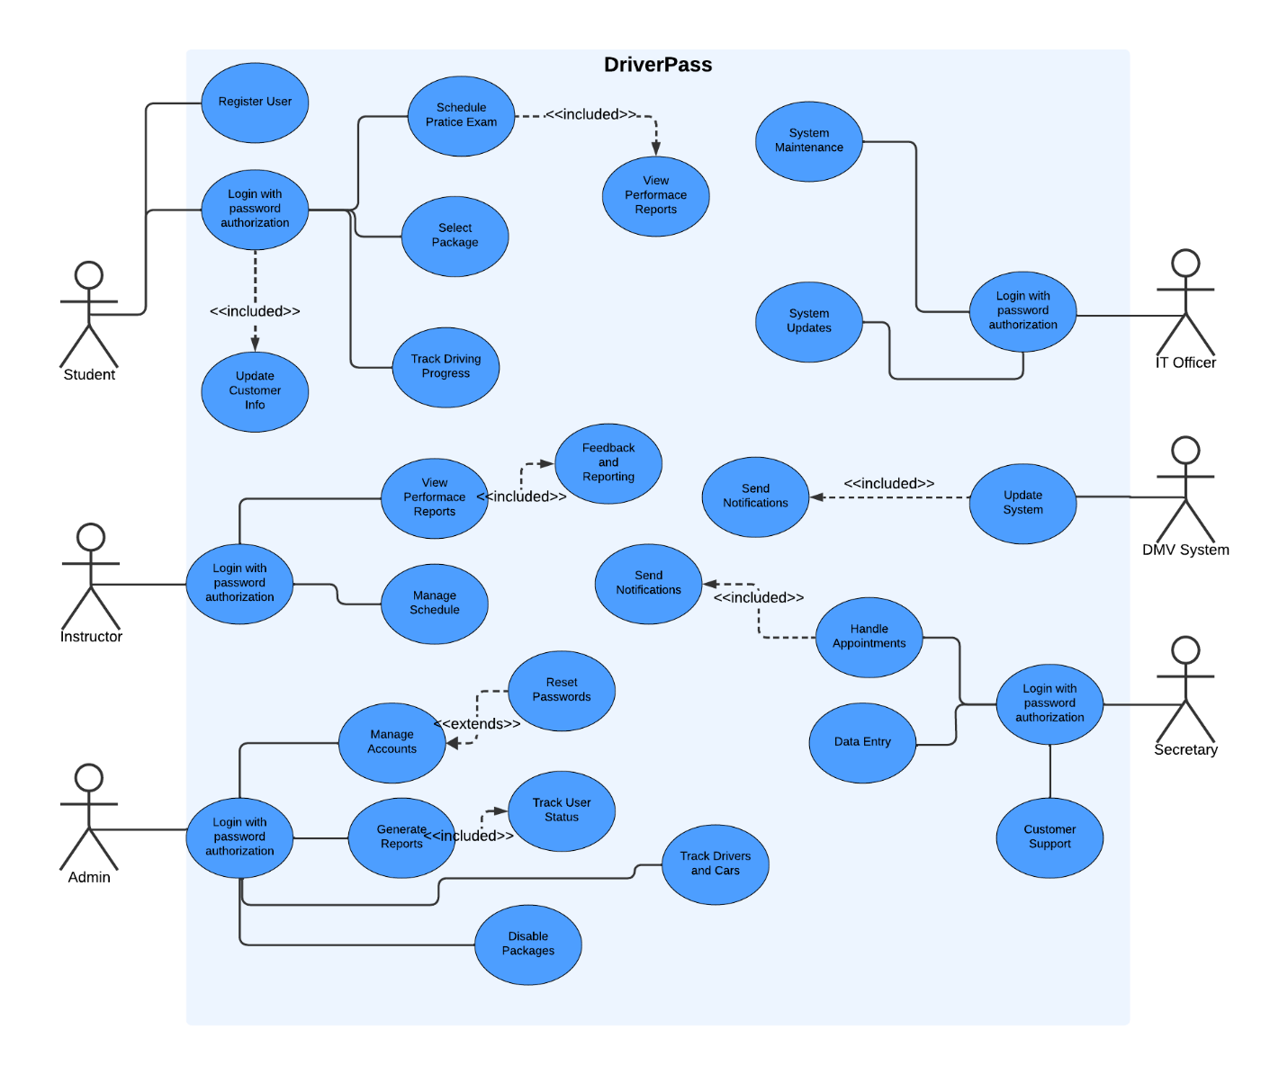
Use Case Diagram
Notes:
The DriverPass system is designed with user roles including students, instructors, admins, secretaries, and IT officers. Students can register for courses, log in securely, select and view course packages, schedule and take lessons, and view their progress and test results. Instructors manage student records and their schedules. Admins handle user accounts, system settings, and generate reports. Secretaries perform data entry and confirmation of scheduling. IT maintains and updates the system. This role-based design allows operations and support for all users involved.
The system's functionalities include lesson scheduling, test-taking, and result viewing. Usability allows for easy navigation for users, while performance and security requirements give a smooth, responsive, and trustworthy experience. High performance minimizes delays while it also enhances the learning experience. Security measures protect user data, allowing users to trust the system. This design meets DriverPass's needs by providing tools for learning.

Slide 4
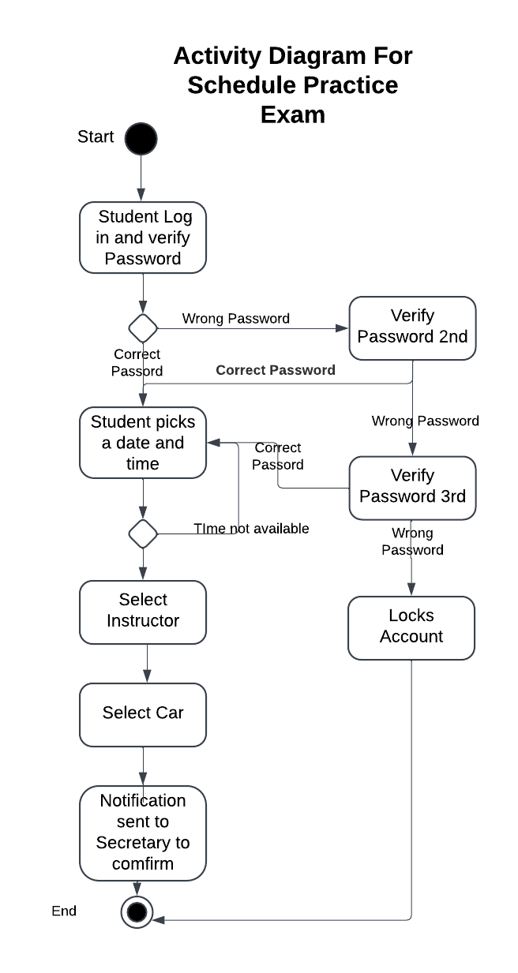
Activity Diagram
Notes:
DriverPass helps students schedule a practice driving exam. First, the student logs in and enters their password. If they get it wrong, they have a total of three tries before their account gets locked. Once logged in, they pick a date and time for their exam. If that slot's already taken, they choose another. Once they have a time that is open they select an instructor and a car. Finally, a notification is sent to the secretary to confirm the booking. This lets the staff check if everything is correct and confirms the booking.
This design is both secure and user-friendly. Multiple password attempts let only authorized users can log in while having flexible scheduling allows students to find convenient times. Letting students choose their instructor and car adds a personal touch, and the secretary's confirmation helps keep everything organized. This approach allows DriverPass to effectively support students while providing a smooth and secure process for scheduling practice exams.

Slide 5
Security
Multiple password attempts locks the account
Secure login with encryption of user data during log in
Data encryption on sensitive information
Role base access to different users to have access to relevant data
Security updates on a regular basis
Secure data storage by having back up system of all data securely to prevent data loss and recovery
Notes:
In the design of the system, we made sure to have security measures in place to protect user information. We allow students a limited number of tries to enter their password correctly before their account is locked. We also use encryption of any sensitive information, like personal details and test results. We store this data securely and make regular backups so that it’s safe from loss or breaches. These steps help make the system both secure and trustworthy for all users.

Slide 6
System Limitations
Scheduling conflicts if lessons are unavailable for the time they wish
Secretary confirmation might delay the process or have human errors
Internet connection is needed for almost all aspects of DriverPass
Security measures of limited incorrect passwords might frustrate users
Notes:
A limitation of the system is that if a student tries to schedule a lesson at a time that’s already taken, they’ll have to choose another slot, which they might not be able to do. With a secretary needing to manually confirm bookings, it will delay the process or even cause human errors. Another issue is that almost everything in DriverPass relies on having a good internet connection, all users need to have access to reliable internet except when driving. The security feature that locks accounts after three incorrect password attempts might be annoying for users if they accidentally mistype their password too many times.

